Slide 1

Automated Planning
Week 5: Applied AI

Slide 2
Content
What is AI Planning?
A Conceptual Model for Planning
Restricting Assumptions
A Running Example: Dock-Worker Robots
PDDL - Planning Domain Definition Language

Slide 3
Defining AI Planning
planning:
explicit deliberation process that chooses and organizes actions by anticipating their outcomes
aims at achieving some pre-stated objectives
AI planning:
computational study of this deliberation process

Slide 4
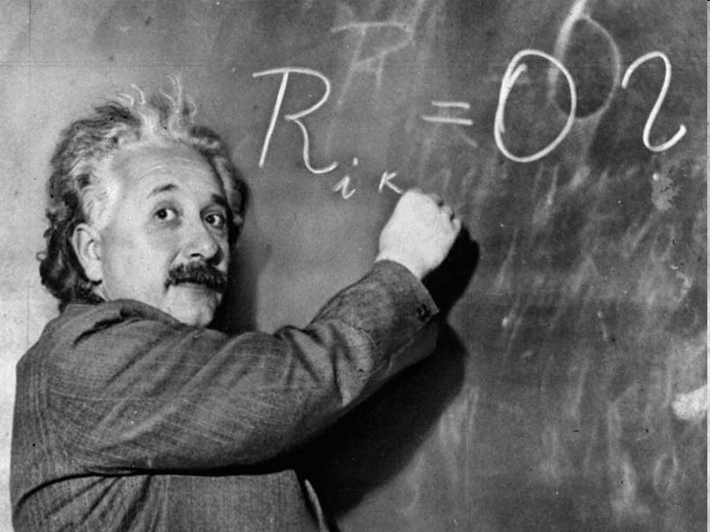
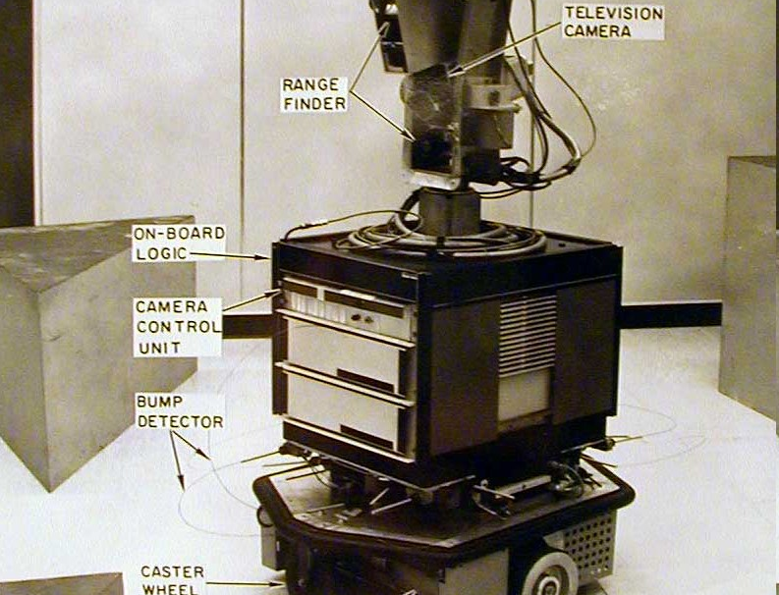
Why Study Planning in AI?
scientific goal of AI: understand intelligence
planning is an important component of rational (intelligent) behaviour
engineering goal of AI: build intelligent entities
build planning software for choosing and organizing actions for autonomous intelligent machines

Slide 5
Application of Planning
Rover mission to Mars
Robotics
Business process modelling
Planning for enterprise risk management
Logistic support
Multiple battery use
Machine Tool Calibration
Computer Games
Road transport modelling
Traffic Accident Management
IBM Watson
And more…

Slide 6
How to Spot a Planning Problem
1) Your problem can be described in a declarative way
2) You have domain knowledge that should not be ignored
3) Pure learning techniques are difficult to use either because there is a structure of the problem that cannot be learned by training or that there is little to no available training data
4) You want to be able to explain a particular course of action the system took
5) You can leverage the existing relationship between a problem that is similar to yours to AI Planning

Slide 7
Real-World Problem: Touring in Romania
Oradea
71
Zerind
Neamt
151
87
75
Iasi
Arad
140
Sibiu
Fagaras
92
118
99
80
Vaslui
Rimnicu Vilcea
Timisoara
97
Pitesti
211
142
111
101
Bucharest
98
Lugoj
85
Hirsova
70
Mehadia
146
Urziceni
86
138
75
Dobreta
90
Eforie
120
Giurgiu
Craiova

Slide 8
Touring Romania:
Search Problem Definition
initial state:
In(Arad)
possible Actions:
DriveTo(Zerind), DriveTo(Sibiu), DriveTo(Timisoara), etc.
goal state:
In(Bucharest)
step cost:
distances between cities

Slide 9
Domain-Specific vs.
Domain-Independent Planning
domain-specific planning: use specific representations and techniques adapted to each problem
important domains: path and motion planning, perception planning, manipulation planning, communication planning
domain-independent planning: use generic representations and techniques
exploit commonalities to all forms of planning
leads to general understanding of planning
domain-independent planning complements domain-specific planning

Slide 10
Content
What is AI Planning?
A Conceptual Model for Planning
Restricting Assumptions
A Running Example: Dock-Worker Robots

Slide 11
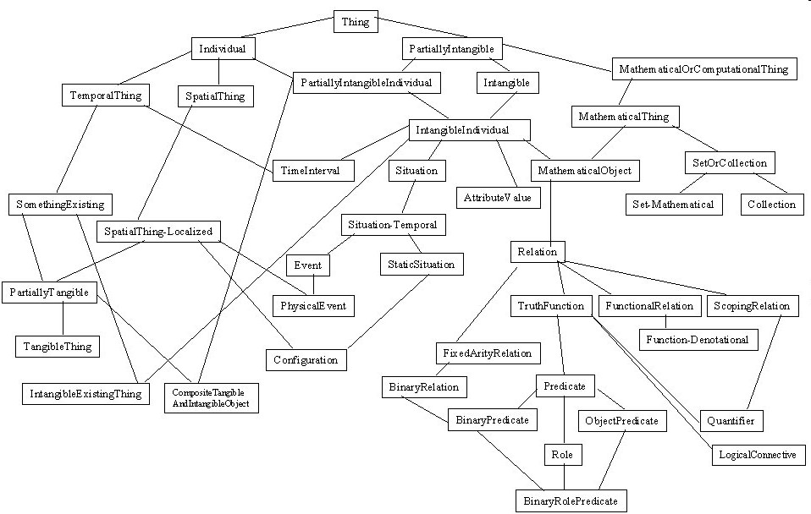
Why a Conceptual Model?
conceptual model: theoretical device for describing the elements of a problem
good for:
explaining basic concepts
clarifying assumptions
analyzing requirements
proving semantic properties
not good for:
efficient algorithms and computational concerns

Slide 12
Conceptual Model for Planning:
State-Transition Systems
A state-transition system is a 4-tuple
Σ = (S,A,E,γ), where:
S = {s₁,s₂,…} is a finite or recursively enumerable set of states;
A = {a₁,a₂,…} is a finite or recursively enumerable set of actions;
E = {e₁,e₂,…} is a finite or recursively enumerable set of events; and
γ: S×(A∪E)→2^{S} is a state transition function.
if a∈A and γ(s,a) ≠ ∅ then a is applicable in s
applying a in s will take the system to s′∈γ(s,a)
Notes:
S – State
A – Action
E – Event that is not controlled by the agent. Event can change the state of the world
Γ – Gamma – State transiction function
2^{s} - Set of states. Power set of all possible states
γ(s,a) Ισ νοτ εμπτψ

Slide 13
State-Transition Systems as Graphs
A state-transition system Σ = (S,A,E,γ) can be represented by a directed labelled graph G = (N_{G},E_{G}) where:
the nodes correspond to the states in S, i.e.
N_{G}=S; and
there is an arc from s∈N_{G} to s′∈N_{G}, i.e. s→s
′∈E_{G}, with label u∈(A∪E) if and only if s′∈γ
(s,a).

Slide 14

Missionary and Cannibals: problem
On one bank of a river, there are three missionaries (black triangles) and three cannibals (red circles). There is one boat available that can hold up to two people and that they would like to use to cross the river. If the cannibals ever outnumber the missionaries on either of the river’s banks, the missionaries will get eaten.
How can the boat be used to safely carry all the missionaries and cannibals cross the river?
Planning problem:
Find a sequence of actions that carries all the missionaries and cannibals safely across the river to the other side

Slide 15
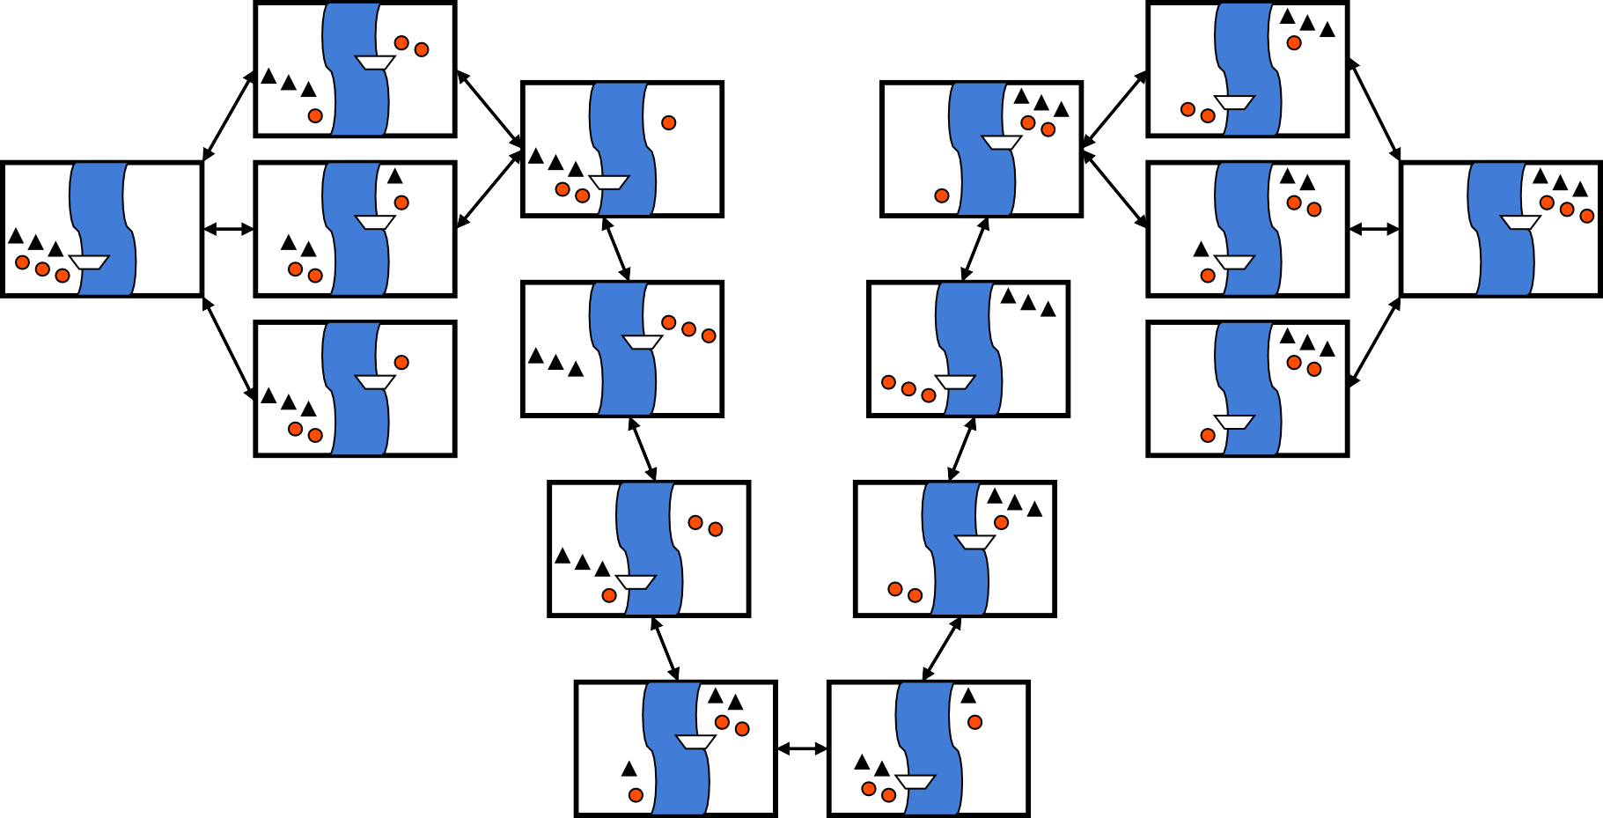
State-Transition Graph Example:
Missionaries and Cannibals
1c
1c
2c
2c
1m 1c
1m
1m
1m 1c
2c
2c
1c
1c
1c
1c
2m
2m
1m 1c

Slide 16
Objectives and Plans
state-transition system:
describes all ways in which a system may evolve
plan:
a structure that gives appropriate actions to apply in order to achieve some objective when starting from a given state
types of objective:
goal state s_{g} or set of goal states S_{g}
satisfy some conditions over the sequence of states
optimize utility function attached to states
task to be performed

Slide 17
Planning and Plan Execution
planner:
given: description of Σ, initial state, objective
generate: plan that achieves objective
controller:
given: plan, current state (observation function: η:S→O)
generate: action
state-transition system:
evolves as actions are executed and events occur
Description of Σ
Initial State
Planner
Objectives
Plan
Controller
Observations Actions
System Σ
Events

Slide 18
Content
What is AI Planning?
A Conceptual Model for Planning
Restricting Assumptions
A Running Example: Dock-Worker Robots
PDDL - Planning Domain Definition Language

Slide 19
Quick Review of Classical Planning
s₁
s₀
Classical planning requires all eight of the restrictive assumptions:
A0: Finite
A1: Fully observable
A2: Deterministic
A3: Static
A4: Attainment goals
A5: Sequential plans
A6: Implicit time
A7: Offline planning
put
take
location 1
location 2
location 1
location 2
move2
move1
move2
move1
s₃
s₂
put
take
location 1
location 2
location 1
location 2
unload
load
s₄
s₅
move2
move1
location 1
location 2
location 1
location 2

Slide 20
A0: Finite Σ
Assumption A0
system Σ has a finite set of states
Relaxing A0
why?
to describe actions that construct or bring new objects into the world
to handle numerical state variables
issues:
decidability and termination of planners

Slide 21
A1: Fully Observable Σ
Assumption A1
system Σ is fully observable, i.e. η is the identity function
Relaxing A1
why?
to handle states in which not every aspect is or can be known
issues:
if η(s)=o, η⁻¹(o) usually more than one state (ambiguity)
determining the successor state

Slide 22
A2: Deterministic Σ
Assumption A2
system Σ is deterministic, i.e. for all s∈S, u∈A∪E: |γ (s,u)|≤1
short form: γ(s,u)=s′ for γ(s,u)={s′}
Relaxing A2
why?
to plan with actions that may have multiple alternative outcomes
issues:
controller has to observe actual outcomes of actions
solution plan may include conditional and iterative constructs

Slide 23
A3: Static Σ
Assumption A3
system Σ is static, i.e. E=∅
short form: Σ = (S,A,γ) for Σ = (S,A,∅,γ)
Relaxing A3
why?
to model a world in which events can occur
issues:
world becomes nondeterministic from the point of view of the planner (same issues)

Slide 24
A4: Restricted Goals
Assumption A4
the planner handles only restricted goals that are given as an explicit goal state s_{g} or set of goal states S_{g}
Relaxing A4
why?
to handle constraints on states and plans, utility functions, or tasks
issues:
representation and reasoning over constraints, utility, and tasks

Slide 25
A5: Sequential Plans
Assumption A5
a solution plan is a linearly ordered finite sequence of actions
Relaxing A5
why?
to handle dynamic systems (see A3: static Σ)
to create different types of plans
issues:
must not shift problem to the controller
reasoning about (more complex) data structures

Slide 26
A6: Implicit Time
Assumption A6
actions and events have no duration in state transition systems
Relaxing A6
why?
to handle action duration, concurrency, and deadlines
issues:
representation of and reasoning about time
controller must wait for effects of actions to occur

Slide 27
A7: Offline Planning
Assumption A7
planner is not concerned with changes of Σ
while it is planning
Relaxing A7
why?
to drive a system towards some objectives
issues:
check whether the current plan remains valid
if needed, revise current plan or re-plan

Slide 28
The Restricted Model
restricted model: make assumptions A0-A7
Given a planning problem P =(Σ,s_{i},S_{g}) where
Σ = (S,A,γ) is a state transition system,
s_{i}∈S is the initial state, and
S_{g} ⊂ S is a set of goal states,
find a sequence of actions 〈a₁,a₂,…,a_{k}〉
corresponding to a sequence of state transitions
〈s_{i},s₁,…,s_{k}〉 such that
s₁= γ(s_{i},a₁), s₂= γ(s₁,a₂),…, s_{k}= γ(s_{k-1},a_{k}), and s_{k}∈S_{g}.

Slide 29
Content
What is AI Planning?
A Conceptual Model for Planning
Restricting Assumptions
A Running Example: Dock-Worker Robots
PDDL - Planning Domain Definition Language

Slide 30
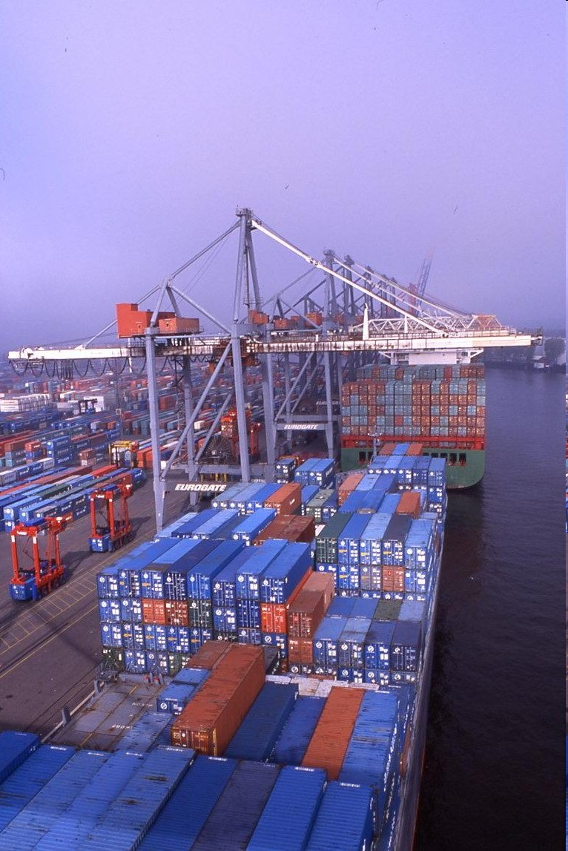
The Dock-Worker Robots (DWR)
Domain
aim: have one example to illustrate planning procedures and techniques
informal description:
harbour with several locations (docks), docked ships, storage areas for containers, and parking areas for trucks and trains
cranes to load and unload ships etc., and robot carts to move containers around

Slide 31




DWR Example State
crane
k1
k2
cc cb ca
cf ce cd
container
pallet
container
l1
r1
l2
pile (p1 and q1)
robot
pile (p2 and q2, both empty)
location

Slide 32
Classical Representation
Start with a first-order language
Language of first-order logic
Restrict it to be function-free
Finitely many predicate symbols and constant symbols, but no function symbols
Example: the DWR domain
Locations: l1, l2, …
Containers: c1, c2, …
Piles: p1, p2, …
Robot carts: r1, r2, …
Cranes: k1, k2, …

Slide 33
Classical Representation
Atom: predicate symbol and args
Use these to represent both fixed and dynamic relations
adjacent(l,l’) attached(p,l) belong(k,l)
occupied(l) at(r,l)
loaded(r,c) unloaded(r)
holding(k,c) empty(k)
in(c,p) on(c,c’)
top(c,p) top(pallet,p)
Ground expression: contains no variable symbols - e.g., in(c1,p3)
Unground expression: at least one variable symbol - e.g., in(c1,x)
Substitution: θ = {x₁ ← v₁, x₂ ← v₂, …, x_{n} ← v_{n}}
Each x_{i} is a variable symbol; each v_{i} is a term
Instance of e: result of applying a substitution θ to e
Replace variables of e simultaneously, not sequentially

Slide 34
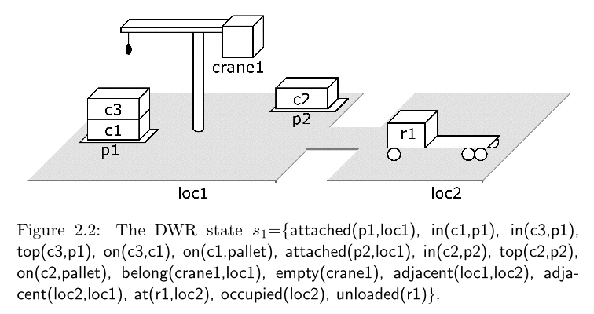
States
State: a set s of ground atoms
The atoms represent the things that are true in one of Σ’s states
Only finitely many ground atoms, so only finitely many possible states
s₁ = {attached(p1,loc1), in(c1,p1), in(c3,p1), top(c3,p1), on(c3,c1), on(c1,pallet), attached(p2,loc1), in(c2,p2), top(c2,p2), on(c2,palet), belong(crane1,loc1), empty(crane1), adjacent(loc1,loc2), adjacent(loc2,loc1), at(r1,loc2), occupied(loc2, unloaded(r1)}

Slide 35
PDDL: Planning Domain Definition Language
language features (version 1.x):
basic STRIPS-style actions
various extensions as explicit requirements
used to define:
planning domains: requirements, types, predicates, possible actions
planning problems: objects, rigid and fluent relations, initial situation, goal description

Slide 36
Components of a PDDL planning task
Objects: Things in the world that interest us.
Predicates: Properties of objects that we are interested in; can be true or false.
Initial state: The state of the world that we start in.
Goal specification: Things that we want to be true.
Actions/Operators: Ways of changing the state of the world.

Slide 37
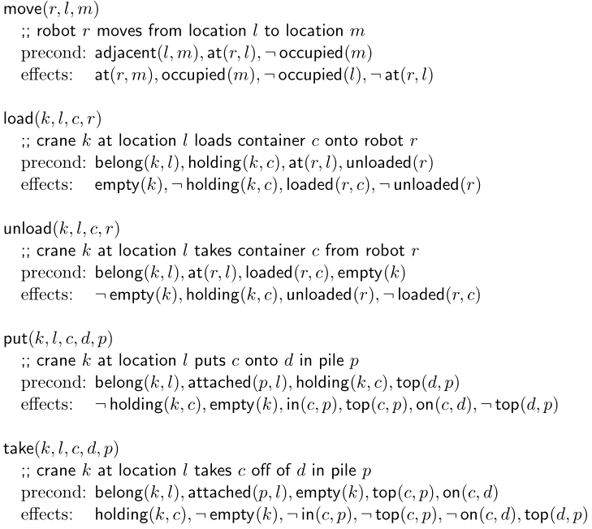
Operators
Operator: a triple o=(name(o), precond(o), effects(o))
precond(o): preconditions
literals that must be true in order to use the operator
effects(o): effects
literals the operator will make true
name(o): a syntactic expression of the form n(x₁,…,x_{k})
n is an operator symbol - must be unique for each operator
(x₁,…,x_{k}) is a list of every variable symbol (parameter) that appears in o
Purpose of name(o) is so we can refer unambiguously to instances of o
Rather than writing each operator as a triple, we’ll usually write like this:

Slide 38
Actions in the DWR Domain
move robot r from location l to some adjacent and unoccupied location l’
take container c with empty crane k from the top of pile p, all located at the same location l
put down container c held by crane k on top of pile p, all located at location l
load container c held by crane k onto unloaded robot r, all located at location l
unload container c with empty crane k from loaded robot r, all located at location l

Slide 39
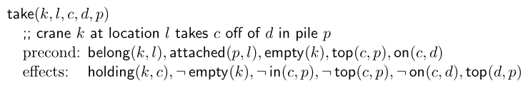
Actions
An action is a ground instance (via substitution) of an operator
Let θ = {k ← crane1, l ← loc1, c ← c3, d ← c1, p ← p1}
Then (take(k,l,c,d,p))θ is the following action:
take(crane1,loc1,c3,c1,p1)
precond: belong(crane,loc1), attached(p1,loc1), empty(crane1), top(c3,p1), on(c3,c1)
effects: holding(crane1,c3), ¬empty(crane1), ¬in(c3,p1), ¬top(c3,p1), ¬on(c3,c1), top(c1,p1)
i.e., crane crane1 at location loc1 takes c3 off of c1 in pile p1

Slide 40
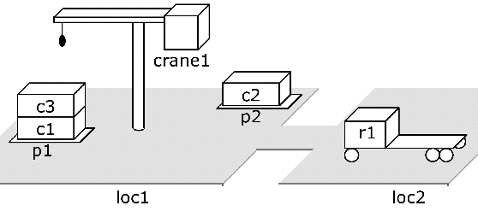
Planning domain: language plus operators
Corresponds to a set of state-transition systems
Example: operators for the DWR domain

Slide 41
Example: DWR Types
(define (domain dock-worker-robot) (:requirements :strips :typing ) (:types location ;there are several connected locations pile ;is attached to a location, ;it holds a pallet and a stack of containers robot ;holds at most 1 container, ;only 1 robot per location crane ;belongs to a location to pickup containers container ) …)

Slide 42
Example: DWR Predicates
(:predicates (adjacent ?l1 ?l2 - location) ;location ?l1 is adjacent to ?l2 (attached ?p - pile ?l - location) ;pile ?p attached to location ?l (belong ?k - crane ?l - location) ;crane ?k belongs to location ?l (at ?r - robot ?l - location) ;robot ?r is at location ?l (occupied ?l - location) ;there is a robot at location ?l (loaded ?r - robot ?c - container ) ;robot ?r is loaded with container ?c (unloaded ?r - robot) ;robot ?r is empty (holding ?k - crane ?c - container) ;crane ?k is holding a container ?c (empty ?k - crane) ;crane ?k is empty (in ?c - container ?p - pile) ;container ?c is within pile ?p (top ?c - container ?p - pile) ;container ?c is on top of pile ?p (on ?c1 - container ?c2 - container) ;container ?c1 is on container ?c2 )

Slide 43
Example: DWR Action
;; moves a robot between two adjacent locations
(:action move :parameters (?r - robot ?from ?to - location) :precondition (and (adjacent ?from ?to) (at ?r ?from) (not (occupied ?to))) :effect (and (at ?r ?to) (occupied ?to)
(not (occupied ?from)) (not (at ?r ?from)) ))

Slide 44
Example: DWR Problem
;; a simple DWR problem with 1 robot and 2 locations (define (problem dwrpb1) (:domain dock-worker-robot) (:objects r1 - robot l1 l2 - location k1 k2 - crane p1 q1 p2 q2 - pile ca cb cc cd ce cf pallet - container) (:init (adjacent l1 l2) (adjacent l2 l1) (attached p1 l1) (attached q1 l1) (attached p2 l2) (attached q2 l2) (belong k1 l1) (belong k2 l2) (in ca p1) (in cb p1) (in cc p1) (on ca pallet) (on cb ca) (on cc cb) (top cc p1)
(in cd q1) (in ce q1) (in cf q1) (on cd pallet) (on ce cd) (on cf ce) (top cf q1) (top pallet p2) (top pallet q2) (at r1 l1) (unloaded r1) (occupied l1) (empty k1) (empty k2))
;; task is to move all containers to locations l2 ;; ca and cc in pile p2, the rest in q2 (:goal (and (in ca p2) (in cc p2) (in cb q2) (in cd q2) (in ce q2) (in cf q2))))

Slide 45
Review
What is AI Planning?
A Conceptual Model for Planning
Restricting Assumptions
A Running Example: Dock-Worker Robots

Slide 46

Questions

Slide 47
References and links
Book – Automated Planning: Theory and Practice
PDF link: https://projects.laas.fr/planning/book.pdf
Run Planner Online - Run planner online:
To run a planner on a domain model and problem
https://web-planner.herokuapp.com/
To write PDDL domain, PDDL Problem and run planning engine using Visual Studio Code.
https://marketplace.visualstudio.com/items?itemName=jan-dolejsi.pddl
PDDL: http://cs-www.cs.yale.edu/homes/dvm/
PDDL Tutorial - https://www.cs.toronto.edu/~sheila/2542/s14/A1/introtopddl2.pdf
Planning wiki - for lots of useful links in AI Planning
https://planning.wiki/

